Slide 1
Chapter 2
Instructions: Language of the Computer

Slide 2
Types of Branches
Branch – change of control flow
Conditional Branch – change control flow depending on outcome of comparison
branch if equal (beq) or branch if not equal (bne)
Unconditional Branch – always branch
a MIPS instruction for this: jump (j)

Slide 3
Types of Branches
Branch to a labeled instruction if a condition is true
Otherwise, continue sequentially
beq rs, rt, L1
if (rs == rt) branch to instruction labeled L1;
bne rs, rt, L1
if (rs != rt) branch to instruction labeled L1;
j L1
unconditional jump to instruction labeled L1

Slide 4
Instruction Labels
An instruction in a source program can have a label
It is a symbolic name for the memory address where the instruction resides
The assembler will calculate the numeric address
Each label in the program must be unique
Labels can be used as operands in some instructions
Typically as targets in branch/jump instructions

Slide 5
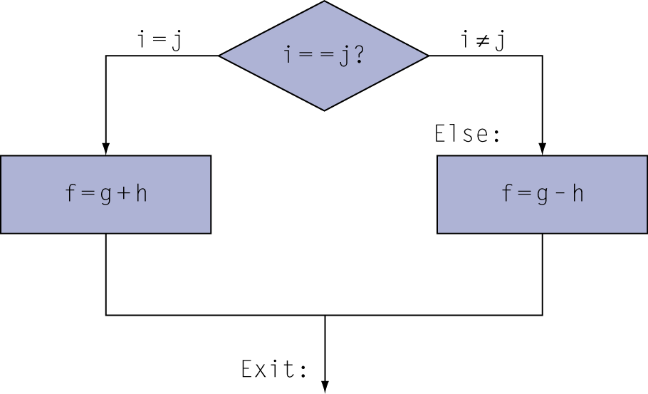
Compiling If Statements
C code:
if (i==j) f = g+h; else f = g-h;
f, g, … in $s0, $s1, …
Compiled MIPS code:
bne $s3, $s4, Else add $s0, $s1, $s2 j Exit Else: sub $s0, $s1, $s2 Exit: …
Assembler calculates addresses

Slide 6
Compiling Loop Statements
C code:
while (save[i] == k) i += 1;
i in $s3, k in $s5, address of save in $s6
Compiled MIPS code:
Loop: sll $t1, $s3, 2 add $t1, $t1, $s6 lw $t0, 0($t1) bne $t0, $s5, Exit addi $s3, $s3, 1 j Loop Exit: …

Slide 7
Coding “if-then-else” in MIPS
C code:
if (i==j) f=g+h; else f=g-h;
MIPS code:
→ f,g,h,i,j are in $s0,$s1,$s2,$s3,$s4
bne $s3,$s4,else # if i!=j goto else add $s0,$s1,$s2 # f=g+h j endif # goto endif else: sub $s0,$s1,$s2 # f=g-h endif: …
reverse the condition logic

Slide 8
Coding a “while” Loop in MIPS
C code:
while (A[i]!=k) i+=1;
MIPS code:
→i is in $s3, k in $s5, base address of A in $s6
loop: sll $t1,$s3,2 # $t1=i*4 add $t1,$t1,$s6 # $t1=$t1+&A lw $t0,($t1) # $t0=memory[$t1] beq $t0,$s5,endl # if done goto endl addi $s3,$s3,1 # i+=1 j loop # goto loop endl: …
reverse the condition logic

Slide 9
Branching Instruction Usage
Conditional branches typically used for
if-else, while, for control structures.
These structures are usually small (< 50 instructions)
Function calls and unconditional jumps handled with jump instructions (J-Format)
Recall: Instructions stored in a localized area of memory (Code/Text)
Address of current instruction stored in the program counter (PC)

Slide 10
Encoding of Conditional Branch Instruction : PC-Relative Addressing
Conditional branch instructions have format I
Recall: MIPS uses 32-bit addresses
Memory is byte-addressed
Instructions are word-aligned
Address is always multiple of 4 (in bytes), meaning it ends with 0b00 in binary
Number of bytes to add to the PC will always be a multiple of 4
op
rs
rt
offset from PC
6 bits
5 bits
5 bits
16 bits

Slide 11
Encoding of Conditional Branch Instruction : PC-Relative Addressing
wordOffset denotes the distance from the instruction pointed by PC to the target Instruction
wordOffset is in units of words (not bytes)
Can now branch ± 2¹⁵ words
We can reach 2¹⁶ instructions = 2¹⁸ bytes around PC.
op
rs
rt
wordOffset from PC
6 bits
5 bits
5 bits
16 bits

Slide 12
Program Execution Model
To run a program, it has to be loaded in main memory
Code (machine instructions)
Data
The CPU has a register called PC (Program Counter)
Contains the address of the next instruction to be executed
PC is not one of the 32 general purpose registers
Instruction Execution Cycle Performed by the CPU logic
Get the next instruction from memory
Address of instruction is in the PC
Advance the PC to the next instruction
PC=PC+4 (instructions are word-aligned)
Execute the instruction
Go back to Step 1
Why PC is modified before instruction is executed ? Hardware reasons; will be clear why later in the course.

Slide 13
Branch Calculation
wordOffset is relevant in step 3 of the execution cycle
Observe that PC was already changed in step 2
Example :
this: beq rs,rt,next
In step 2 of the execution cycle: PC = this + 4
Therefore, in step 3:
next = PC + wordOffset*4 = this + 4 + wordOffset*4
wordOffset = (next – this - 4)/4
wordOffset is calculated by the assembler.

Slide 14
Branch Example (1/2)
Start counting from instruction AFTER the branch
MIPS Code:
Loop: beq $9,$0,End addu $8,$8,$10 addiu $9,$9,-1 j Loop End:
I-Format fields:
opcode = 4 (look up on Green Sheet)
rs = 9 (first operand)
rt = 0 (second operand)
immediate = ???
1
2
3
3

Slide 15
Branch Example (2/2)
MIPS Code:
Loop: beq $9,$0,End addu $8,$8,$10 addiu $9,$9,-1 j Loop End:
Field representation (decimal):
Field representation (binary):
31
0
4
9
0
3
31
0
000100
01001
00000
0000000000000011

Slide 16
PC-Relative addressing
If we don’t take the branch:
PC = PC + 4 = next instruction
If we do take the branch:
PC = (PC + 4) + (immediate*4)
Does the value in branch immediate field change if we move the code?
If moving individual lines of code, then yes
If moving all of code, then no
Notes:
As we will see, jumping instructions can reach farther than branching

Slide 17
Conditional Branch Design
MIPS has only “branch if equal” or “not equal”
Why not blt (branch if less than), bge (greater or equal), etc.?
Hardware for <, ≥, … is slower than =, ≠
Entails more work per instruction
→ Requires a slower clock
→All instructions are penalized by slower clock!
beq and bne are the common case
This is a good design compromise
So, how can we use other conditional branches?

Slide 18
More Conditional Operations
Set register to 1 if less than
slt rd,rs,rt
if (rs < rt) then rd = 1; else rd = 0;
slti rt,rs,immediate
if (rs < immediate) then rt = 1; else rt = 0;
This can be used in combination with beq, bne to form any conditional branch (<,<=,>,>=)
Example: coding of “branch if less or equal”
if ($s1 ≤ $s2) branch to label
slt $at,$s2,$s1 #if ($s2<$s1) $at=1; else $at=0
beq $at,$0,label #if $at=0 goto label
interim register

Slide 19
More Conditional Operations
Set result to 1 if a condition is true
Otherwise, set to 0
slt rd, rs, rt
if (rs < rt) rd = 1; else rd = 0;
slti rt, rs, constant
if (rs < constant) rt = 1; else rt = 0;
Use in combination with beq, bne
slt $t0, $s1, $s2 # if ($s1 < $s2) bne $t0, $zero, L # branch to L

Slide 20
Signed vs. Unsigned
Signed comparison: slt, slti
Unsigned comparison: sltu, sltui
Example
$s0 = 1111 1111 1111 1111 1111 1111 1111 1111
$s1 = 0000 0000 0000 0000 0000 0000 0000 0001
slt $t0, $s0, $s1 # signed
–1 < +1 ⇒ $t0 = 1
sltu $t0, $s0, $s1 # unsigned
+4,294,967,295 > +1 ⇒ $t0 = 0

Slide 21
Dealing With Large Immediates (1/2)
How do we deal with 32-bit immediates?
Sometimes want to use immediates > ± 2¹⁵ with addi, lw, sw and slti
Bitwise logic operations with 32-bit immediates
Solution: Don’t mess with instruction formats, just add a new instruction
Load Upper Immediate (lui)
lui reg,imm
Moves 16-bit imm into upper half (bits 16-31) of reg and zeros the lower half (bits 0-15)

Slide 22
Dealing With Large Immediates (2/2)
How can we load a 32-bit constant into a register?
10101010101010101100110011001100₂ = aaaacccc₁₆
Split it in two halves, and use 2 “immediate” instructions
First, insert the upper half using “load upper immediate”
lui $at,0xaaaa
Then, insert the lower half using “or immediate”
ori $t0,$at,0xcccc
This is available as the “load immediate” pseudo-instruction
li $t0,0xaaaacccc
all zeros
$at
1010101010101010
0000000000000000
$at
1010101010101010
0000000000000000
Bitwise OR
immediate
0000000000000000
1100110011001100
$t0
1010101010101010
1100110011001100

Slide 23
Assembler Pseudo-Instructions
Most assembler instructions represent machine instructions one-to-one.
Certain C statements are implemented unintuitively in MIPS
e.g. assignment (a=b) via add zero
MIPS has a set of “pseudo-instructions” to make programming easier
More intuitive to read, but get translated into actual instructions later
Example:
move dst,src translated into addi dst,src,0
blt $t0, $t1, L translated into
slt $at, $t0, $t1 bne $at, $zero, L
$at (register 1): assembler temporary

Slide 24
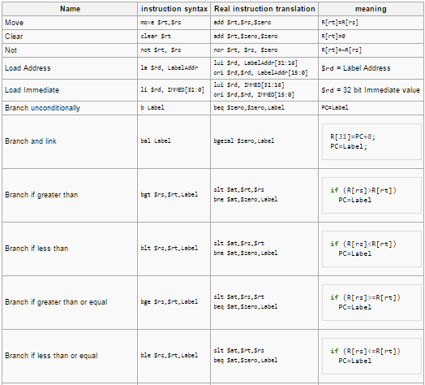
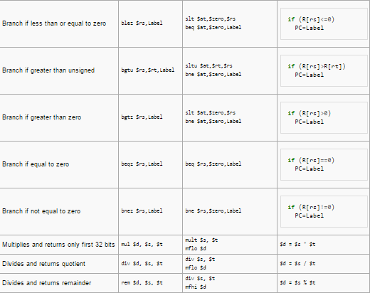
Assembler Pseudo-Instructions
MARS has additional pseudo-instructions - See Help (F1) for full list

Slide 25
Assembler Register
Problem:
When breaking up a pseudo-instruction, the assembler may need to use an extra register
If it uses a regular register, it’ll overwrite whatever the program has put into it
Solution:
Reserve a register ($1 or $at for “assembler temporary”) that assembler will use to break up pseudo-instructions
Since the assembler may use this at any time, it’s not safe to code with it

Slide 26
Pseudo-Instructions for Data Access via Labels
The address (location) of a label is a 32-bit constant
A label can be used as pointer to data
Assume labels y and list are declared in the data segment
.data 0x100104a0
y: .word 100
list: .word 0:10
Load/store word at label
lw/sw $s4,y
Pseudo-instruction is implemented by:
lui $at,0x1001
lw/sw $s4,0x04a0($at)
Load address of label
la $s5,y
Same as “load immediate” of a 32-bit constant (shown previously)
Load/store word in an array at label
lw/sw $t1,list($t2)
Register $t2 is an offset (“quasi-index”) into the array
Pseudo-instruction is Implemented by:
lui $at,0x1001
addu $at,$at,$t2
lw/sw $t1,0x04a4($at)

Slide 27
MAL vs. TAL
True Assembly Language (TAL)
The instructions a computer understands and executes
MIPS Assembly Language (MAL)
Instructions the assembly programmer can use (includes pseudo-instructions)
Each MAL instruction becomes 1 or more TAL instruction
TAL ⊂ MAL

Slide 28
J-Format Instructions (1/5)
For branches, we assumed that we won’t want to branch too far, so we can specify a change in the PC
For general jumps (j and jal), we may jump to anywhere in memory
Ideally, we would specify a 32-bit memory address to jump to
Unfortunately, we can’t fit both a 6-bit opcode and a 32-bit address into a single 32-bit word

Slide 29
J-Format Instructions (2/5)
Define two “fields” of these bit widths:
As usual, each field has a name:
Key Concepts:
Keep opcode field identical to R-Format and I-Format for consistency
Collapse all other fields to make room for large target address
31
0
6
26
31
0
opcode
target address

Slide 30
J-Format Instructions (3/5)
We can specify 2²⁶ addresses
Still going to word-aligned instructions, so add 0b00 as last two bits (multiply by 4)
This brings us to 28 bits of a 32-bit address
Take the 4 highest order bits from the PC
Cannot reach everywhere, but adequate almost all of the time, since programs aren’t that long
Only problematic if code straddles a 256MB boundary

Slide 31
J-Format Instructions (4/5)
Conditional Branch to a Far Target
When a program is very large, the target of a conditional branch might be too far away
Farther than +/- 2¹⁵ instructions away
Offset cannot be encoded using 16 bits
Solution: rewrite the code
Reverse the condition logic
Use unconditional jump to the far instruction
Example:
ble $s0,$s1,Far
bgt $s0,$s1,Near
j Far Near: …

Slide 32
J-Format Instructions (5/5)
Jump instruction:
New PC = { (PC+4)[31..28], target address, 00 }
Notes:
{ , , } means concatenation { 4 bits , 26 bits , 2 bits } = 32 bit address
Book uses || instead
Array indexing: [31..28] means highest 4 bits
For hardware reasons, use PC+4 instead of PC

Slide 33
Questions on PC-addressing
What do we do if destination of a conditional branch is > 2¹⁵ instructions away from branch?
Other instructions save us
beq $s0,$0,far bne $s0,$0,next # next instr → j far next: # next instr
Notes:
As we will see, jumping instructions can reach farther than branching

Slide 34
Unconditional Jump via Register
Unconditionally jump to the address contained in a register
jr rs
Instruction has format R
Only the rs register is relevant
Main Use:
When the full target address is computed by the program

Slide 35
Target Addressing Example
Loop code from earlier example
Assume Loop at location 80000
Loop: sll $t1, $s3, 2 | 80000 | 0 | 0 | 19 | 9 | 4 | 0
add $t1, $t1, $s6 | 80004 | 0 | 9 | 22 | 9 | 0 | 32
lw $t0, 0($t1) | 80008 | 35 | 9 | 8 | 0
bne $t0, $s5, Exit | 80012 | 5 | 8 | 21 | 2
addi $s3, $s3, 1 | 80016 | 8 | 19 | 19 | 1
j Loop | 80020 | 2 | 20000
Exit: … | 80024

Slide 36
Instruction Encoding Example
Assume Loop is at address 65536₁₀ (=10000₁₆)
Notice the crossed order of registers in the binary code
Except in branch instructions
6 5 5 5 5 6
Loop: add $t2, $t1, $s6 | 65536 | 0 | 9 | 22 | 10 | 0 | 32
sll $t1, $s3, 2 | 65540 | 0 | 0 | 19 | 9 | 2 | 0
lw $t0, -8($t1) | 65544 | 35 | 9 | 8 | -8
bne $t0, $s5, End | 65548 | 5 | 8 | 21 | 2
addi $s3, $s4, 12 | 65552 | 8 | 20 | 19 | 12
j Loop | 65556 | 2 | 16384
End: … | 65560
rd
(End ‒(PC+4))>>2 = (65560 ‒(65548+4))/4=2
rs
(Loop&0x0FFFFFFF)>>2 = 65536/4 = 16384
rt

Slide 37
Instruction Encoding Example (Cont.)
Binary and hexa representation of the encoding
Binary by field Hexa Decimal by field
6 5 5 5 5 6
6 5 5 5 5 6
000000 01001 10110 01010 00000 100000 | 01365020 | 0 | 9 | 22 | 10 | 0 | 32
000000 00000 10011 01001 00010 000000 | 00134880 | 0 | 0 | 19 | 9 | 2 | 0
100011 01001 01000 1111111111111000 | 8d28fff8 | 35 | 9 | 8 | -8
000101 01000 10101 0000000000000010 | 15150002 | 5 | 8 | 21 | 2
001000 10100 10011 0000000000001100 | 2293000c | 8 | 20 | 19 | 12
000010 00000000000100000000000000 | 08004000 | 2 | 16384
16384₁₀ = 2¹⁴= 4000₁₆

Slide 38
Encoding of MIPS Instructions
Uniform 32-bit instruction length
Three different formats: R, I, J
Formats are aligned as much as possible
Common field positions and semantics
op – opcode rs – 1st source register
funct – function-code rt – 2nd source register / target register
shamt – shift amount rd – destination register
immediate – 16-bit constant/offset
address – 26-bit “pseudo-direct” address
6 5 5 5 5 6
op rs rt rd shamt funct
R
I
J
op rs rt immediate
op address

Slide 39
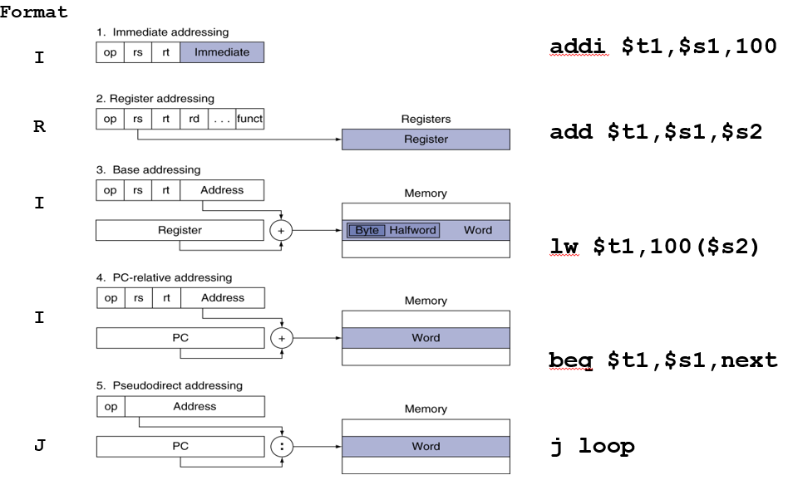
MIPS Addressing Modes

Slide 40
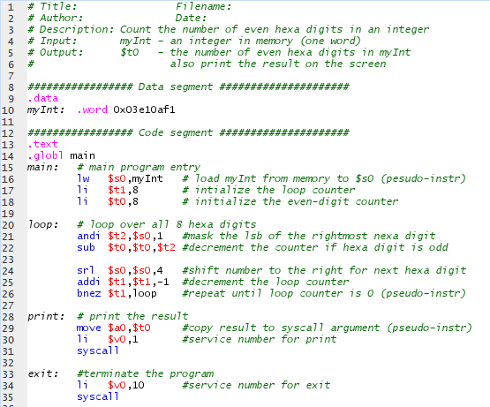
Our First MIPS Program!

Slide 41
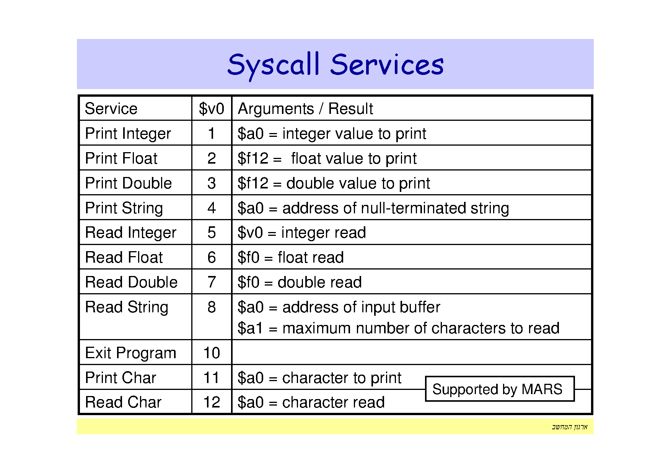

Slide 42
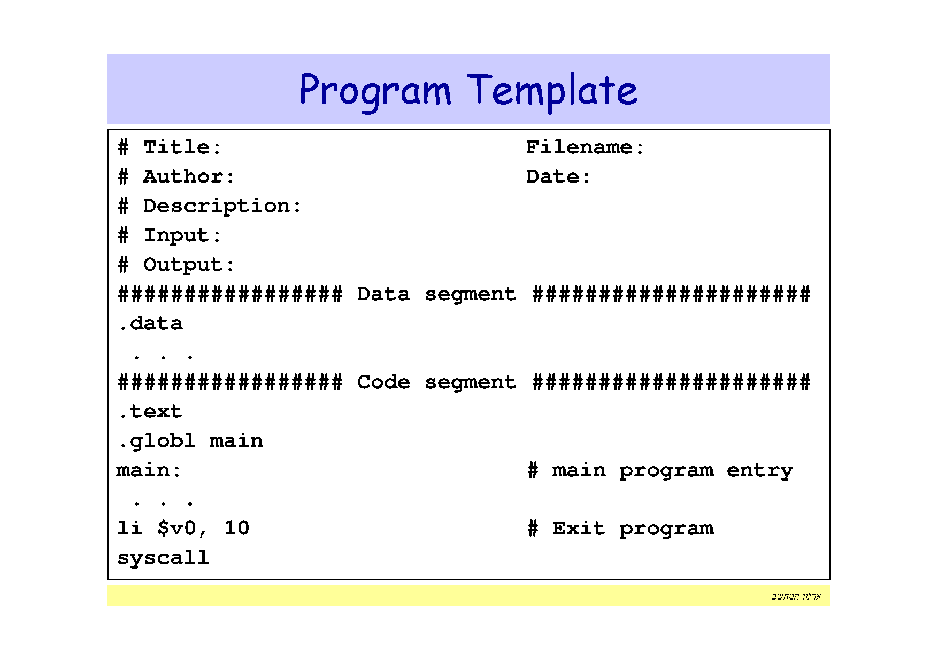

Slide 43
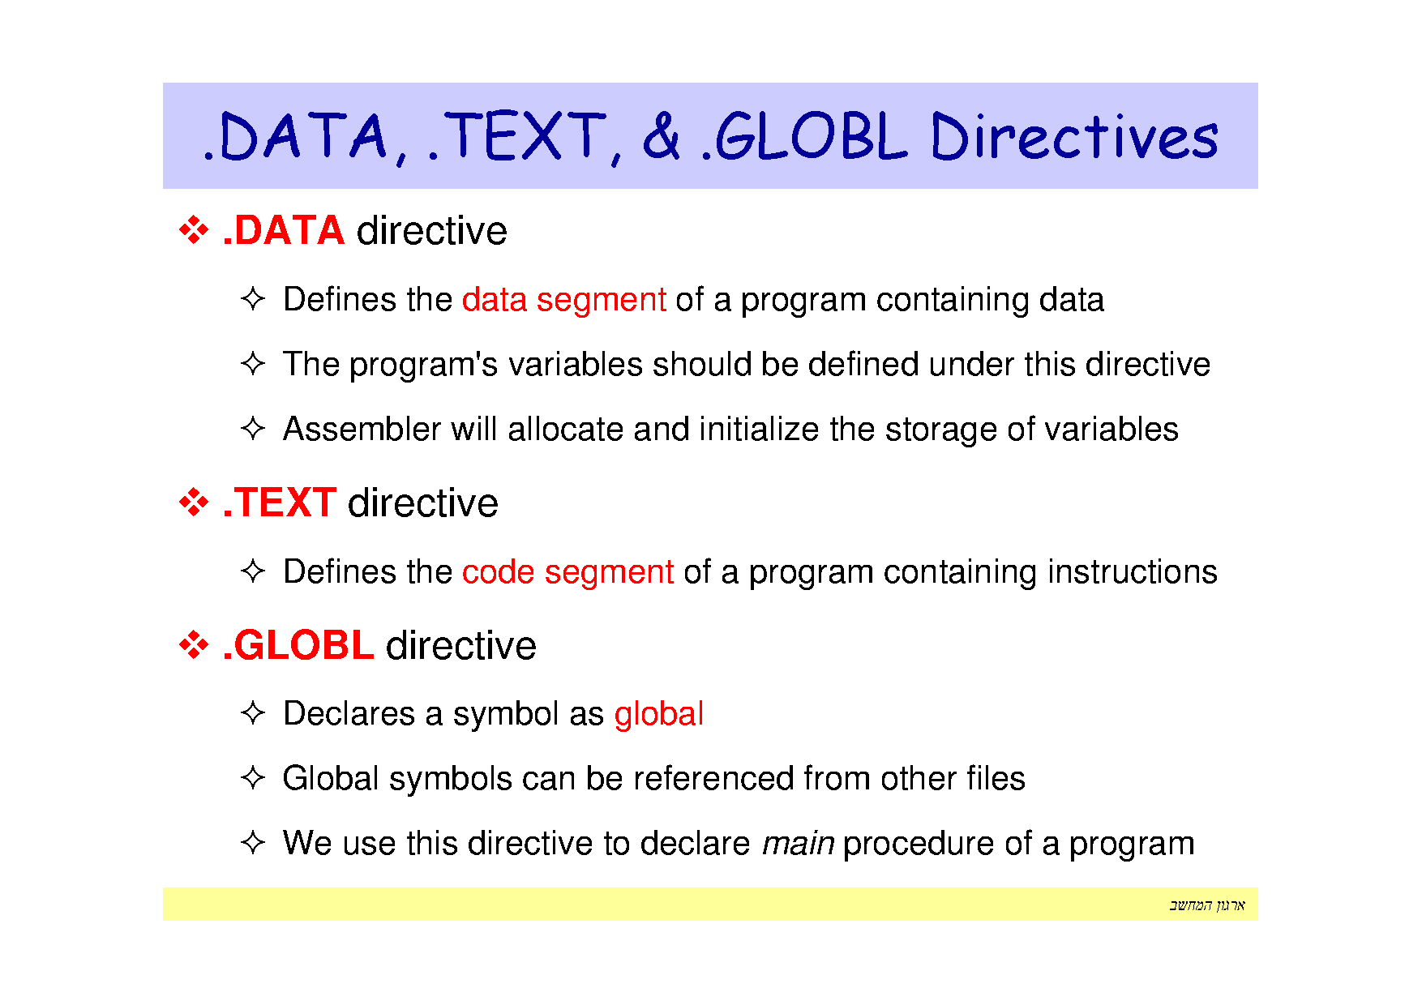

Slide 44
